Slide 1
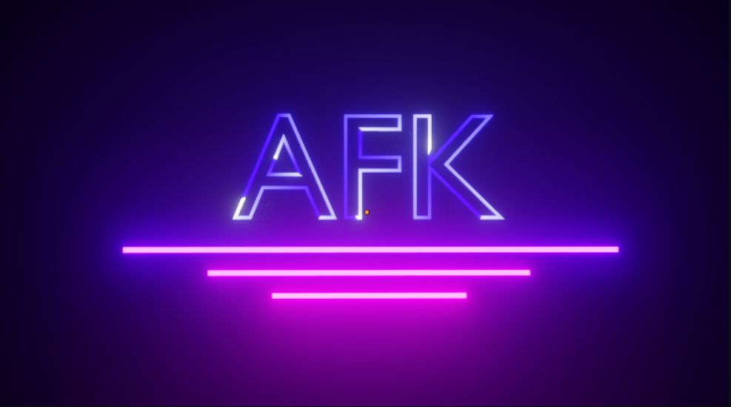
Cerutti, Dutto, Martini, Mellano, Rostagno

Slide 2
Who we are
We are 5 guys from 4^B rob class and in this 2 weeks of PCTO we decided to create a game implements trajectories drawing.

Slide 3
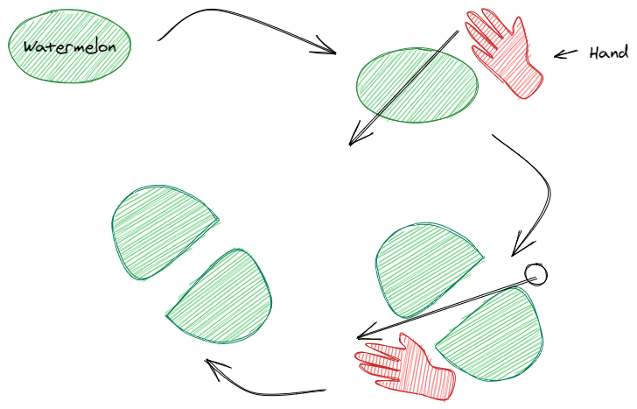
The first idea was created a game similar to Ninja Fruits.
In this game some fruits are “throw” in the air and the player has to cut these with his finger.
Our idea was implements this game with human hand.

Slide 4



What we use
We use Blender for drawing our objects and Unity 2018.4.1 like development environment and OpenPose like technology for detect movements.

